Slide 1

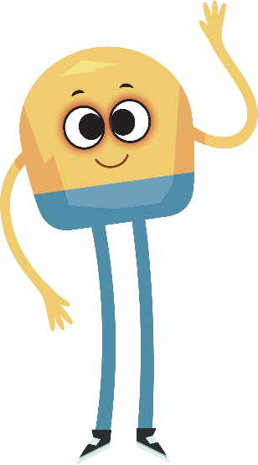

Unit 3: Week 1
Grade K

Slide 2
Copyright © Savvas Learning Company LLC. All Rights Reserved.
This publication is protected by copyright, and permission should be obtained from the publisher prior to any prohibited reproduction, storage in a retrieval system, or transmission in any form or by any means, electronic, mechanical, photocopying, recording, or otherwise. For information regarding permissions, request forms, and the appropriate contacts within the Savvas Learning Company Rights Management group, please send your query to:
Savvas Learning Company LLC, 15 East Midland Avenue, Paramus, NJ 07652
or
k12learningpermissions@savvas.com
myView Literacy® is an exclusive trademark of Savvas Learning Company LLC in the U.S. and/or other countries.

Slide 3
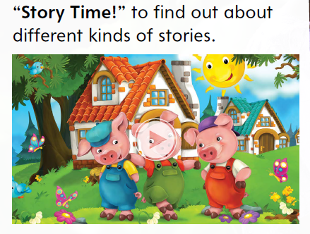


Page 8
Introduce the Unit
Essential Question: Why do we like stories?
What are some of your favorite stories?
What about those stories makes them your favorites?
Notes:
Introduce the Essential Question for Unit 2: Why do we like stories? Tell students that they will read stories in a variety of genres. Tell them that this variety is important because each story shows the theme in a different way.
Watch the Unit Video – Explain that a multimedia text uses sound and pictures. Tell them that a video is an example of this type of text. Show the Unit 3 video, and have students look closely at the pictures and listen to the sounds Click Path: Table of Contents -> Unit 3: I Spy-> Unit 3: Introduction
Have partners discuss the kinds of stories they like. Guide their discussion with the following questions:
• What are some of your favorite stories?
• What about those stories makes them your favorites?

Slide 4
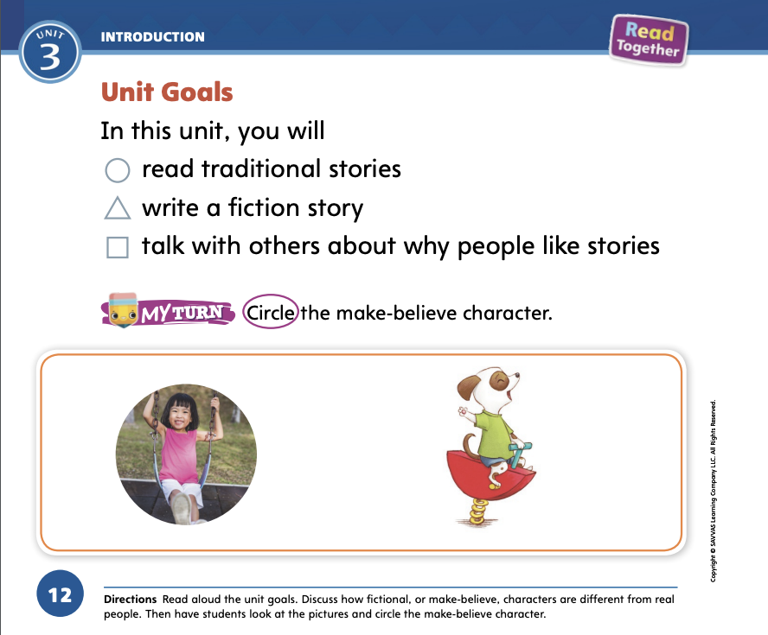
Page 12
    Unit Goals
Turn to page 12 in your
Student Interactive.
Color the shape next to
each goas as it is read.
Notes:
Read aloud the goals from p. 12 of the Student Interactive.
Tell students to color the shape next to each goal as it is read.
Discuss with students how make-believe characters and real people are different. Use the photograph and illustration on p. 12 for reference. Have students circle the make-believe character in the box.

Slide 5
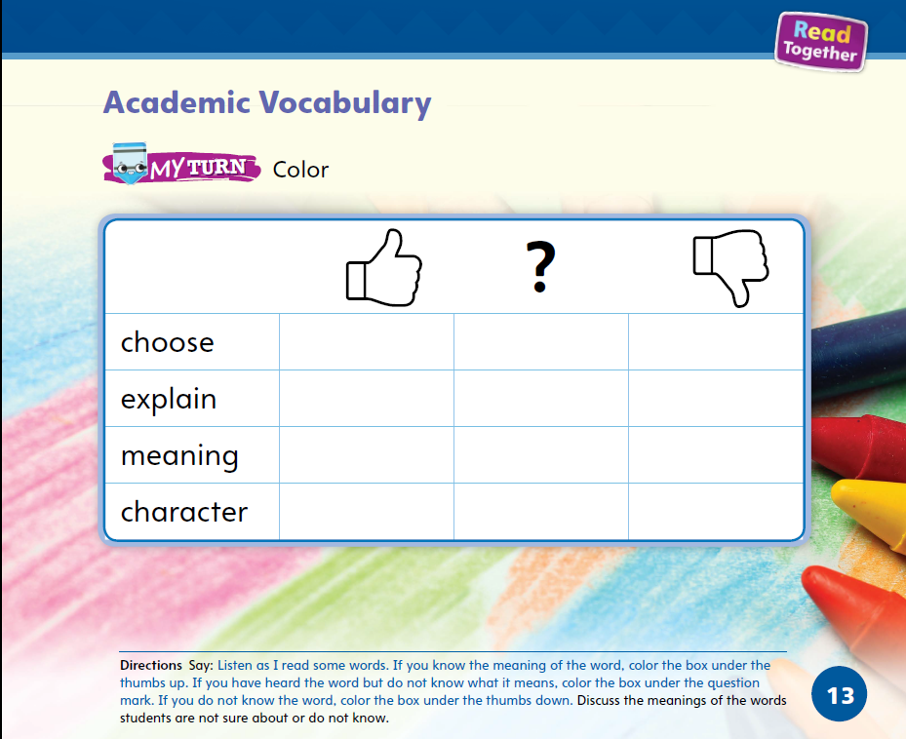
Page 13
Academic Vocabulary
Turn to page 13 in your Student Interactive.
Notes:
Academic Vocabulary is used to discuss ideas. Tell students that as they work throughout the unit, they will learn and use these words in relation to stories.
Guide students to p. 13 in the Student Interactive. Read the words and then say the statements below.
I know the word choose.
I know the word explain.
I know the word meaning.
I know the word character.
Have students hold their thumbs up if they know the word. For students who know the words, have them use the newly acquired Academic Vocabulary in oral sentences. For those who hold their thumbs down, model the words in sentences.

Slide 6
Lesson 1

Slide 7
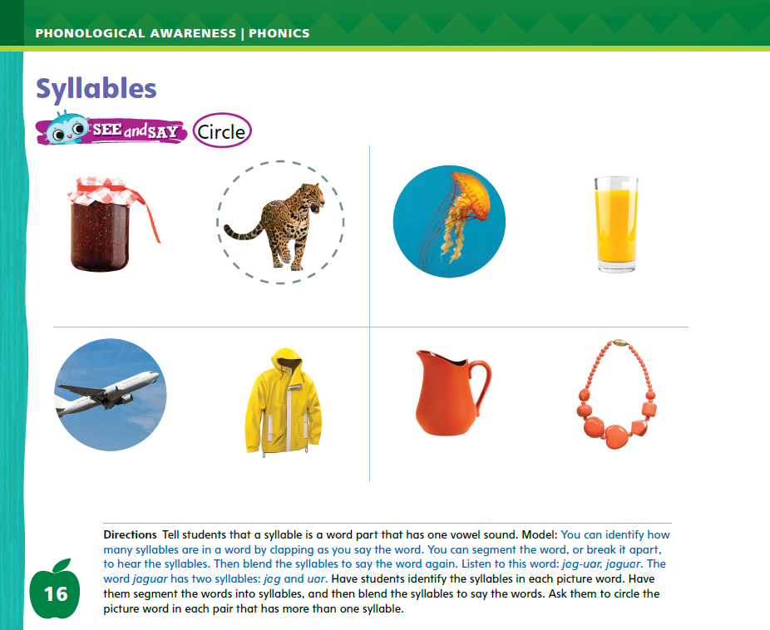
Page 16
Phonological Awareness
Turn to page
16 in your Student Interactive.
water
bubble
Notes:
Tell students that today they will learn about syllables.
All words have syllables. A syllable is a word part that has one vowel sound. You can break apart, or segment, the syllables in a word and tell how many syllables you hear. You can then put the syllables back together, also called blending. Listen to the word water. Water has two syllables: bub (clap) ble (clap), bubble. I can clap for each syllable. Now try it with me.
Students should clap each syllable as you say water. Repeat with blue (one syllable) and lemon (two syllables).
Have students turn to p. 16 in the Student Interactive. Tell them to identify the syllables in each picture word.
Have them segment the words into syllables, and then blend the syllables to say the words.
Finally, have them circle the picture words that have more than one syllable.
Let’s look at the first pair of pictures. I see jam and a jaguar. Let’s clap the syllables: jam (clap); jag (clap) uar (clap), jaguar. How many times did we clap for jam? Students should say one. How many times did we clap for jaguar? Students should say two. Let’s circle the jaguar.
Name each picture with students. Then have them finish the page.

Slide 8
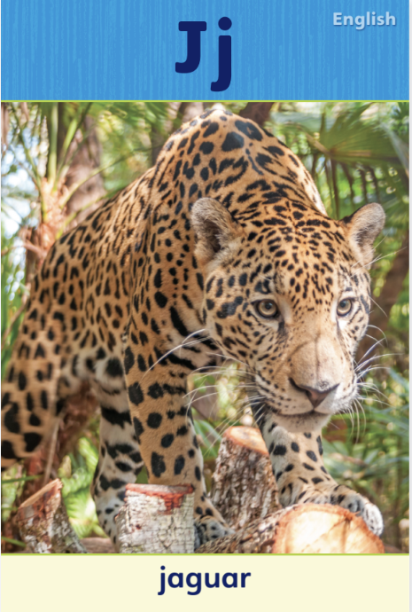
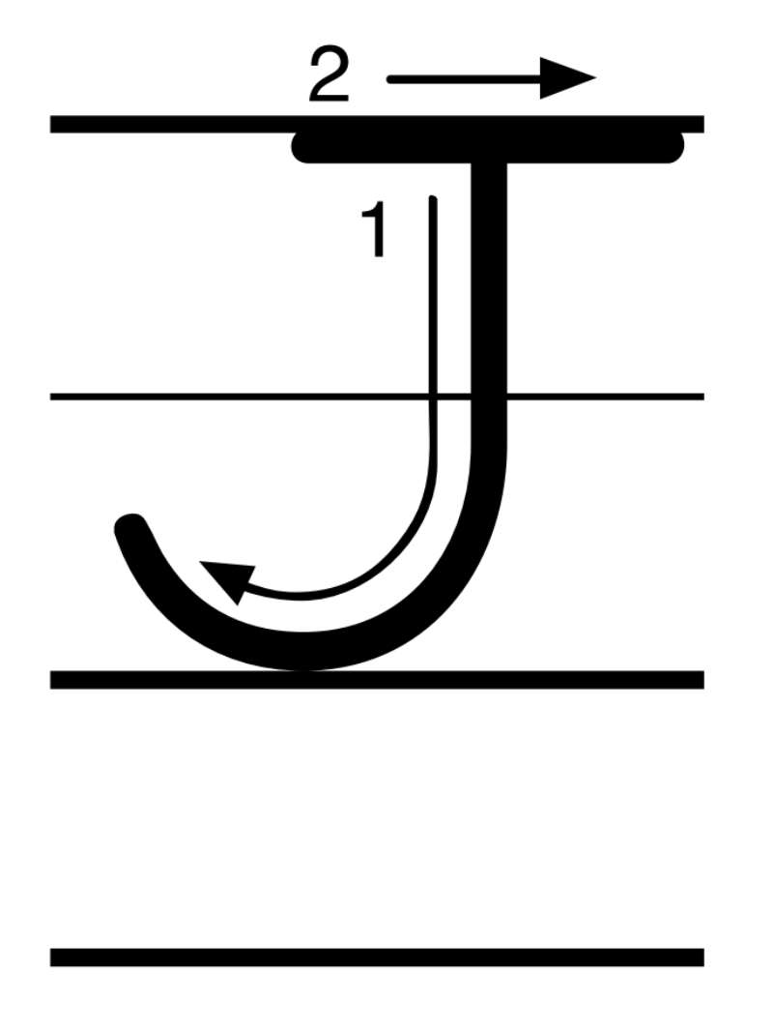
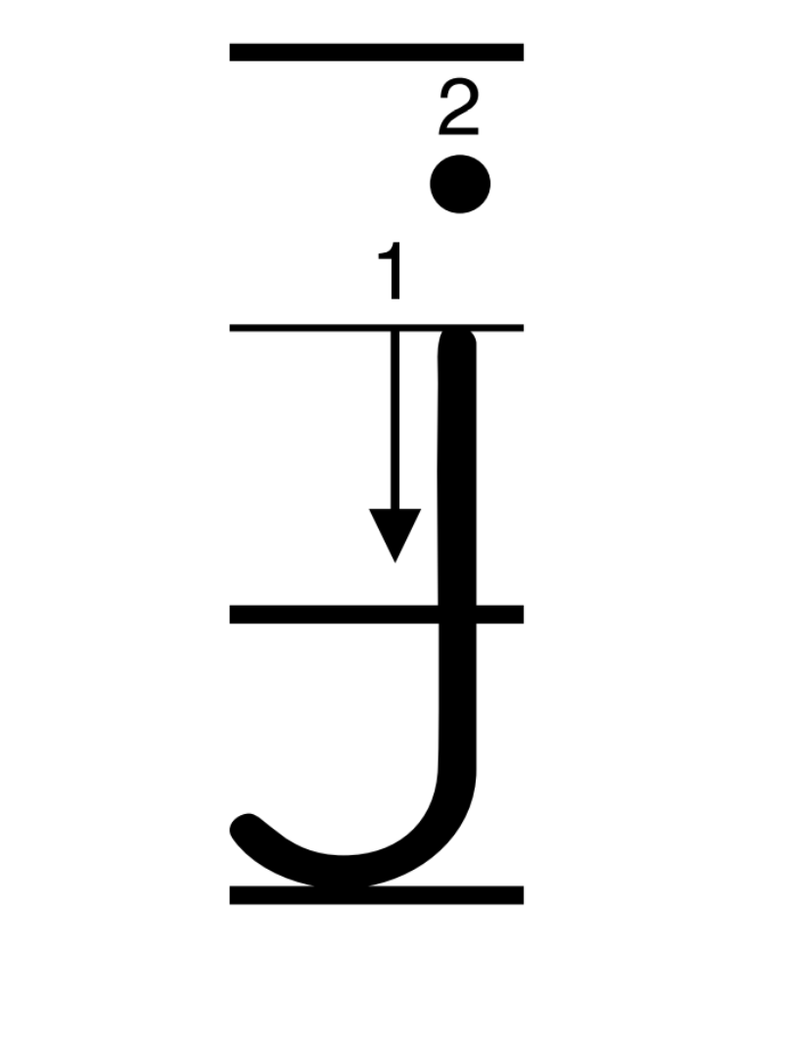
Page 17
Phonics
Notes:
Hold up Alphabet Card Jj and point to the jaguar. Have students say jaguar with you. Let’s say the sound at the beginning of the word jaguar. The beginning sound is /j/ -aguar. The sound /j/ is spelled with the letter j. Show students the letters Jj on the card. Click path -> Table of Contents -> Unit 3 Week 1 Folktale -> Lesson 1
Write the letters Jj on the board. Have students turn to p. 17 in the Student Interactive and trace the letters Jj. Tell students you will say a group of words. Ask them to listen for the sound /j/. If the sound /j/ is at the beginning of the word, they should trace the letter j in the air. Use the following words: jog, bed, Jim, jade, jolt, dance.

Slide 9
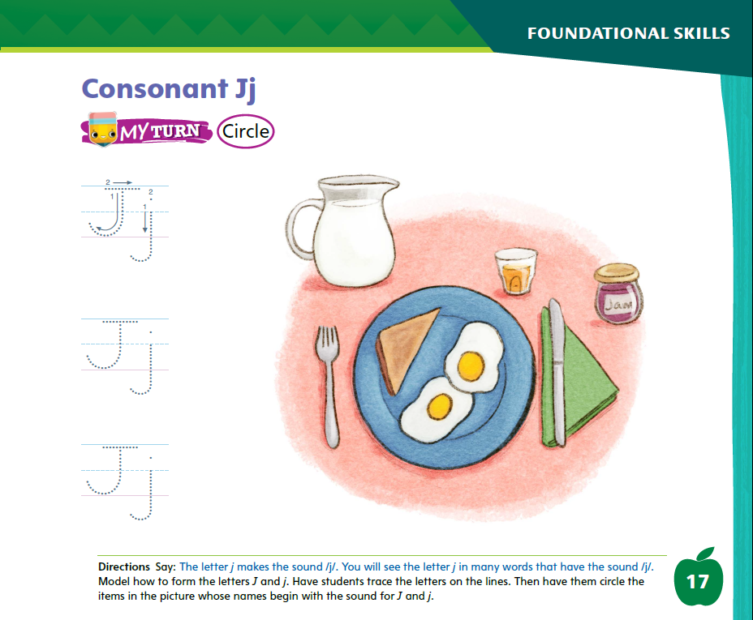
Page 17
Phonics
Turn to page
17 in your Student Interactive.
Notes:
Have students look at p. 17 in the Student Interactive. Point to the letter j and tell me the sound it spells. Now we will circle each word that begins with /j/.
Direct students to look at the jug of milk. Let’s say this word: /j/ /j/ /j/ /u/ /g/. Does the word jug begin with the sound /j/? Yes, it does, so we will circle it.
Identify the images for students, and have them finish the page.

Slide 10
High-Frequency Words
was
said
where
Notes:
Display the high-frequency words was, said, and where.
Point to the word was and read it.
Have students point to the word was and read it.
Repeat for said and where.

Slide 11
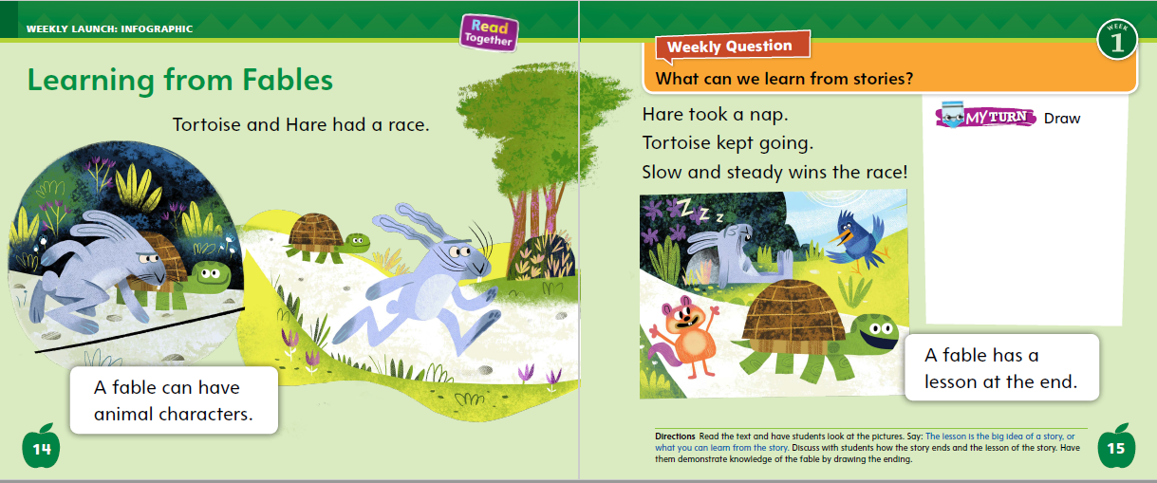
Page 14, 15
Interact with Sources
A fable has a lesson at the
end. What
lesson does this fable teach us?
Draw a picture
of the ending.
Notes:
Remind students of the Essential Question for Unit 3: Why do we like stories? Point out the Week 1 Question: What can we learn from stories? Explain that students will learn about stories this week.
Have students turn to p. 14 of the Student Interactive. Read aloud the heading.
Engage students in the topic by asking them what their favorite story is. Then turn their attention to the page. Ask: What do you see on this page? (turtle, rabbit) Raise your hand if you know the story of the tortoise and the hare. This is a special kind of story called a fable. A fable often has animal characters. Remember, the characters are the main people or animals that the story is about.
Use the following prompts to guide discussion:
Read aloud the text on pp. 14–15, having students follow along and look at the pictures.
Explain to students that a fable has a lesson at the end. The lesson is the big idea of the story, or what we can learn from it.
Talk with students about the ending of the fable, and about the lesson it teaches.
Have students demonstrate understanding of the fable by drawing a picture of the ending.
Read aloud the Week 1 Question: What can we learn from stories? Ask students what they can learn from the story of the tortoise and the hare. Guide them to understand that the story tells about the importance of continuing to try even when you feel behind. Explain that you will be thinking more about what can be learned from stories this week.

Slide 12
Listening Comprehension
“Goldilocks”
Characters
Setting
Theme
Notes:
Tell students that they will listen to a story. Like all stories, this story has characters and a setting. It also has a lesson.
Have students listen as you read aloud “Goldilocks.” Tell students to be active listeners by thinking about the meaning of the story as you read aloud.
Have students ask and answer questions about key details to demonstrate their understanding of the text.
Have students listen actively for the characters, setting, and main idea, or theme.
READ the entire text aloud without stopping for the Think Aloud callouts.
REREAD the text aloud, pausing to model Think Aloud strategies related to the genre.

Slide 13
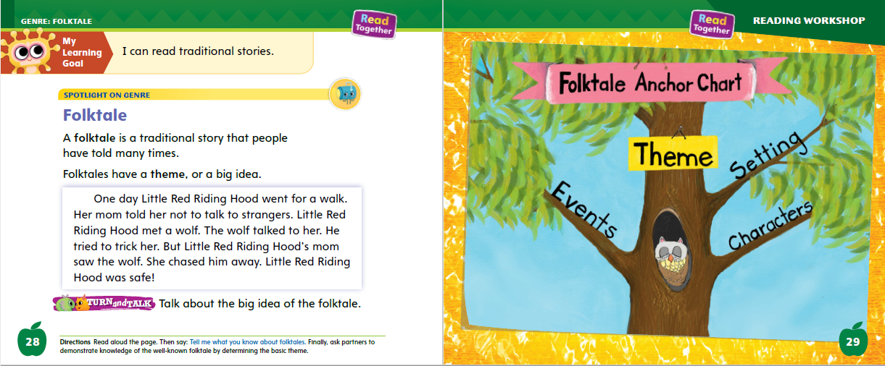
Page 28, 29
Folktale Qualities
Turn to page
28 in your Student Interactive.
Notes:
Tell students that folktales are traditional stories. This means that they have been told many times for many years. Explain that folktales have some distinguishing characteristics.
Folktales are told by parents and other adults to children, who then tell them to their children.
Like other stories, a folktale has characters, a setting, and events.
Folktales also have a theme, or big idea.
Folktales often teach a moral, or lesson.
Students can determine the theme by using text evidence to understand what the story is about. Often, the moral of the story can support the theme and explain why the story was written.
Ask students to raise their hand if they have heard the story of Little Red Riding Hood. Point out that many children have heard this story because it has been told many times. It is an example of a folktale. Ask students to tell you what they know about folktales.
Read the Anchor Chart on p. 29 in the Student Interactive and read aloud the folktale on p. 28. Say: This folktale has characters, a setting, and events. The characters are Little Red Riding Hood, her mom, and the wolf. The setting is the woods. The events are her walking, the wolf approaching her, and her mom chasing the wolf away. Explain that the events can provide evidence for determining the theme of the story. Editable Anchor Chart Click Path: Table of Contents -> Reading Anchor Charts -> Unit 3 Week 1: Folktale Editable Reading Anchor Chart

Slide 14
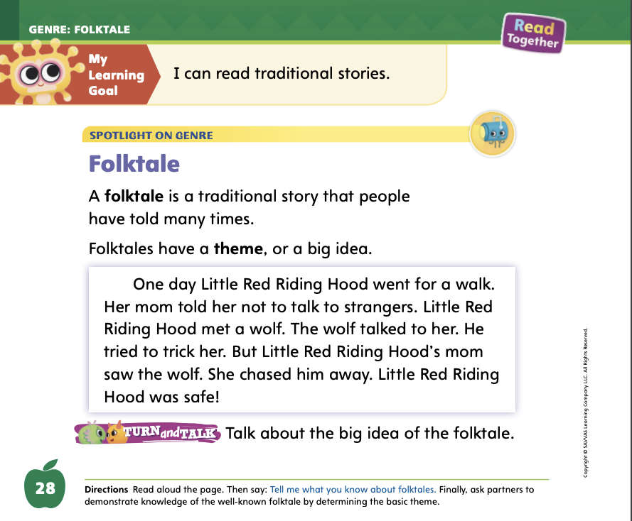
Page 28
Apply
Talk about why Little Red Riding Hood is a folktale.
Notes:
Have students use the strategies to identify folktales.
Have students turn and talk with a partner about the story of Little Red Riding Hood. Then have partners share with the class why they think it is a folktale.

Slide 15
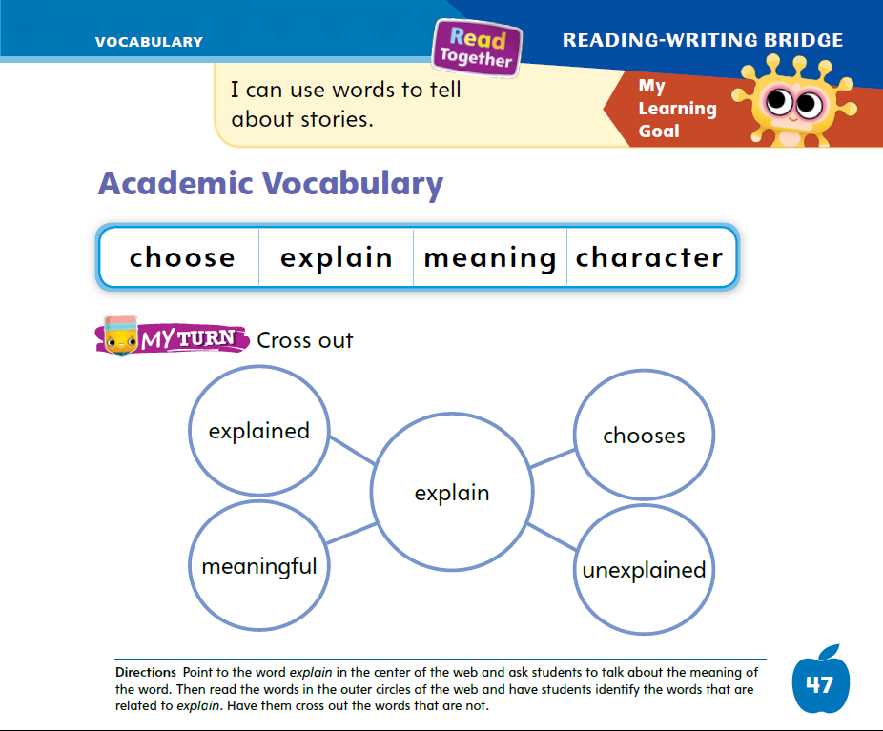
Page 47
Academic Vocabulary
character
Notes:
Tell students that word parts can be added to words to make new words. Word parts can be added at the beginning or the end of a word.
Write the word character on the board. Say: This is a word you know, character. I can add an -s to this word to make a new word. Character means one person or animal in a book. Characters means more than one. These words are related. Characteristic is another word that is related to character.
Write characteristic on the board and underline the word parts that are added. Characteristic means “a quality of a person or thing.” Knowing related words can help readers figure out the meaning of new words.
Read the Academic Vocabulary words on p. 47 of the Student Interactive. Call on different students to tell the meaning of a word.

Slide 16
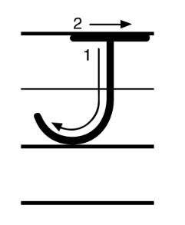
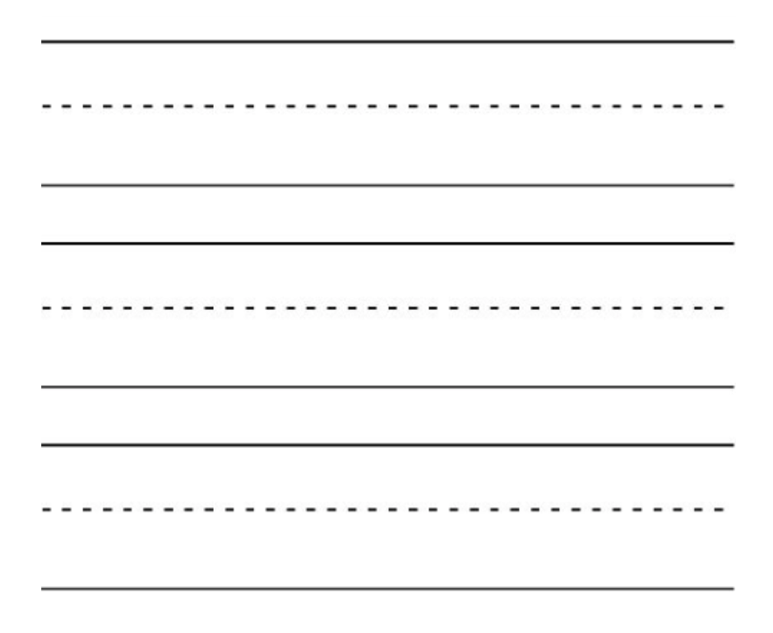
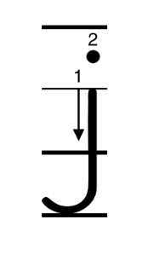
Handwriting
Notes:
Show students the alphabet. Challenge students to find the letters Jj.
Say: Today we are going to practice writing the letter j. Notice that the letter j look like a fishhook. The capital and lowercase letters are similar, but the capital J is wearing a hat and the lowercase j has a dot.
Write the uppercase and lowercase Jj on the board. Point out the differences as you form each letter. Then have students practice making the letters in the air.
Have students use Handwriting p. 138 in the Resource Download Center to practice writing Jj. Click path: Realize -> Table of Contents -> Resource Download Center -> Handwriting Practice -> U3W1L1 Handwriting Practice

Slide 17
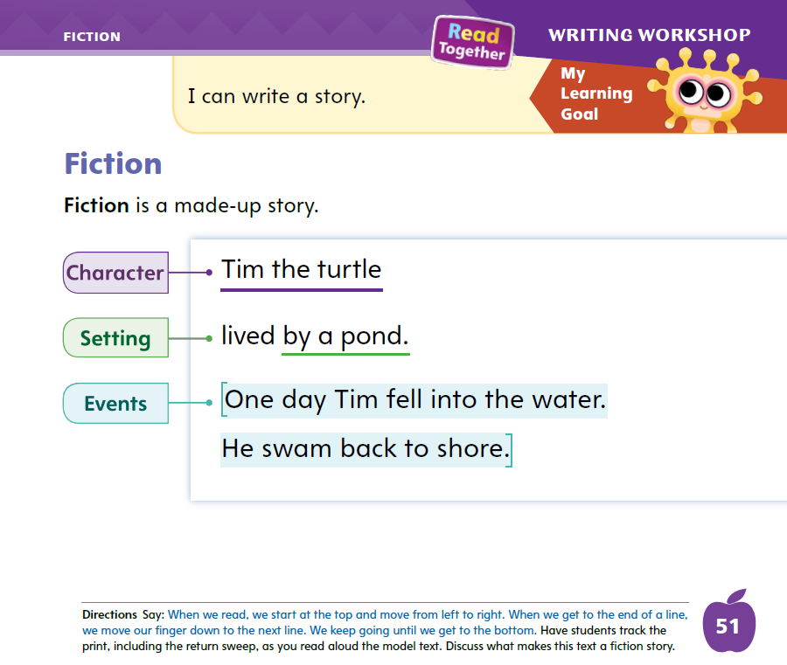
Page 51
Writing – Fiction
Turn to page 51 in your Student Interactive.
Notes:
A fictional story is made up. It includes characters, setting, and plot events.
Select a fiction book from the stack. Demonstrate how to hold the book right side up. Tell students: This is a fiction book. A fictional story is a made-up story. In the story, there are characters. There is a setting. And there is a plot, or something that happens. Let’s read this book together and think about why it is a fiction book.
Read the book aloud. As you read, explain how to turn the pages correctly. Also track the print with your finger to show students how reading moves from top to bottom and left to right with return sweep.
After reading, tell students: A fiction book has characters. Does this book have characters? Who are the characters? Work with students to name the characters. Show pictures from the book to help students remember.
A fiction book has a setting. A setting is where and when the story happens. Where and when does this story happen? Assist students in naming the setting.
A fiction book has a plot, or events. Does something happen in this book? What happens in this book? Help students give a general summary.
This book is a fiction book. It has characters, a setting, and a plot. In this unit, we will write fiction books too. Read additional books from the stack, pointing out the features that make them fiction
Have students turn to p. 51 in the Student Interactive. Review the elements of a fictional story: characters, setting, and events (plot).

Slide 18

Independent Writing
Think of ideas for you own fiction books.
Share ideas you have for your story.
Notes:
During Independent Writing time, students can continue reading stack books if they need more time to develop their understanding of fiction.
If students struggle, choose one of the following options to provide further support.
Modeled Show stack texts of fictional stories and repeat the definition of fiction.
Shared With students’ input, make a list of fictional stories they know.
Guided Prompt students to think about what they could include in their fictional story.
If students demonstrate understanding, they can begin thinking of ideas for their own fiction books. Distribute stapled booklets for students to write in.
Call on a few students to share the ideas they have for their stories.

Slide 19
Language and Conventions
We learn today.
We will learn tomorrow.
Practice using verbs in the present and future tense with your partners.
Notes:
Explain that some verbs are action words. Verbs can describe actions that happened in the past, present, and future.
Write on the board and read aloud examples of sentences in present and future tenses: “We learn today.” This sentence tells what we are doing now. “We will learn tomorrow.” This sentence tells what we will do in the future. Notice the word will is added before the verb to show this.
Have students think of a verb. Use the verb in a simple sentence in present tense. I walk to the playground. Challenge them to tell you what the sentence would be in future tense. Give them sentence frames as needed: I ___ to the playground tomorrow.

Slide 20
Lesson 2

Slide 21

Phonics
jet
jam
jot
gas
let
Jim
mop
ran
jog
Notes:
Hold up the jet Picture Card. Say: This is a jet. I hear the sounds /j / -et. I hear the sound /j / at the beginning of jet. Say the sound /j/ with me: /j /. Click path -> Table of Contents -> Unit 3 Week 1 Folktale -> Lesson 2
Turn over the card and show students the spelling of the word jet. Point to the j and say /j/. Have students identify the letter j. Say the word jet. Do you hear the sound /j/? What letter spells the sound /j/? Write the letters Jj on the board. /j / at the beginning of jet. Say the sound /j / with me: /j /.
Point to the letters Jj on the board. Listen carefully to the following words: jam, jot. What sound do those words begin with? Repeat the words with me: jam, jot. Have a volunteer identify that the words begin with /j/.
What letter spells the sound /j/? Students should identify the letter j.
Tell students that you will read a group of words. Have them raise their hands when they hear a word with /j/. Write these words on the board and read them aloud one at a time: gas, let, Jim, mop, ran, jog.

Slide 22
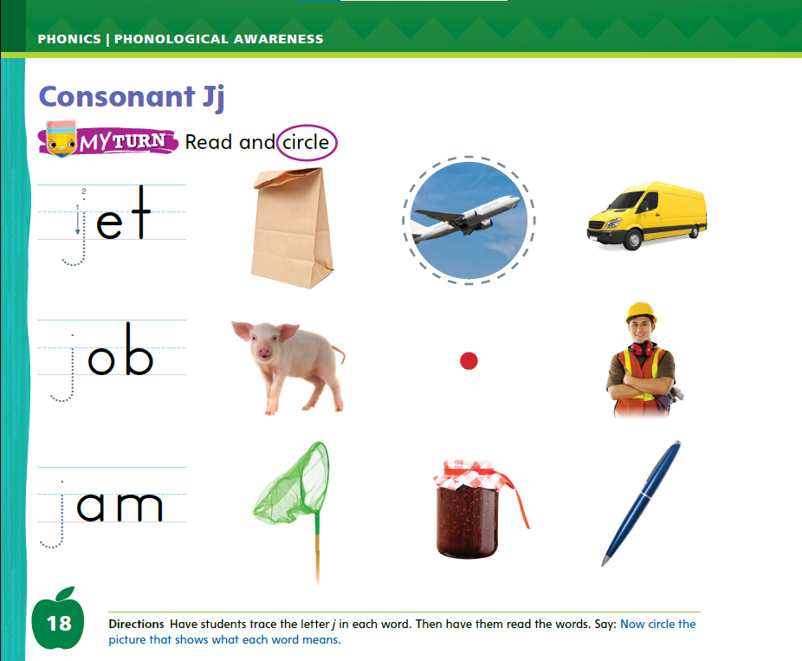
Page 18
Apply
Turn to page 18 in your Student Interactive and complete the activity.
Notes:
Have students complete p. 18 in the Student Interactive. They should write the letter j in each word, the word, and circle the matching picture.
Say: Circle the picture that shows what each word means.

Slide 23
High-Frequency Words
was
said
where
Notes:
Tell students that high frequency words are words that they will hear and see over and over in texts.
Write and read the sight words was, said, and where. Have students:
repeat the words after you
spell each word, clapping as they say each letter.

Slide 24
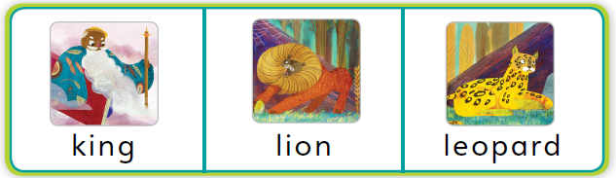
Page 30
Preview Vocabulary
Notes:
Introduce the words king, lion, and leopard from p. 30 of the Student Interactive. Explain that these words will be in the story.
As you read each word, have students point to the picture. Ask them to share what they already know about these words. Suggest they look for these words as you read.
Hold up a book. Books can be very different. They can be long or short. Some have pictures, and others do not. However, books also have some parts that the same.
Identify the front cover, back cover, inside pages, and title page. Point out the book’s title and the name of the author (person who wrote the book) on the front cover and the title page. Have students identify these parts of the Student Interactive and find the title on the title page.

Slide 25
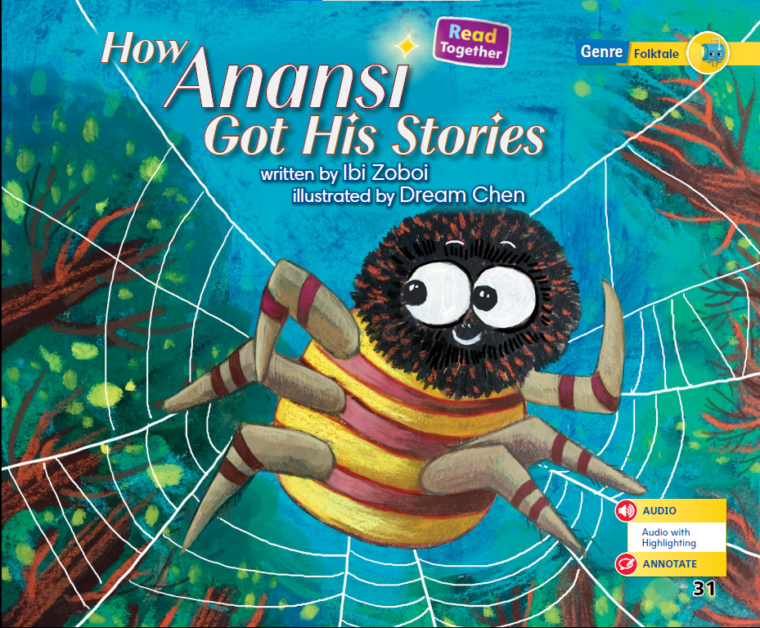
Page 31
First Read Strategies
Notes:
Discuss the First Read Strategies. Ask students why they want to read this text. Maybe they wonder who Anansi is, or they like reading stories. When the First Read is over, ask: What did you like? What surprised you?
READ Follow along with the reading.
LOOK Look at the pictures to understand the text.
ASK Ask questions about words or phrases you do not understand.
TALK Talk to a partner about the text.
Students may read independently, in pairs, or as a class. Use the First Read notes to help students connect with the text and guide their understanding.

Slide 26
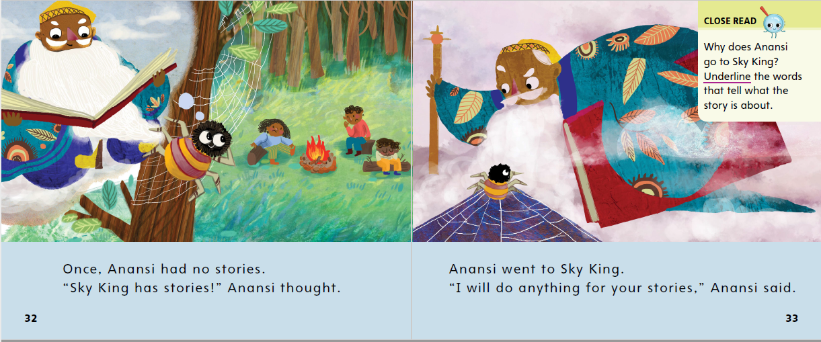

Page 32, 33
First Read – How Anansi Got His Stories
Notes:
Read Together.
THINK ALOUD The first sentence of the story says that Anansi had no stories. I know that stories usually have a problem to be solved. This must be Anansi’s problem. I wonder how he will solve it. I will read on to find out.

Slide 27
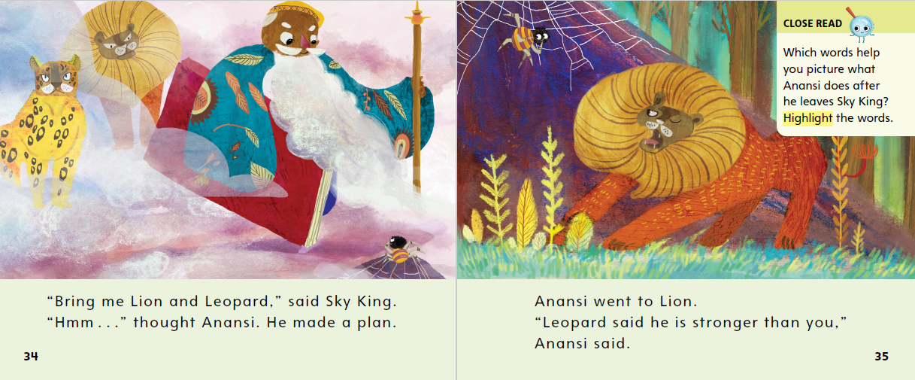
Page 34, 35
First Read – How Anansi Got His Stories
Notes:
Read Together.
THINK ALOUD Readers can learn about characters and the setting by looking at the pictures. The picture of the Sky King on p. 34 shows that he is old. He looks wise and powerful. The words in the text do not tell me much about the Sky King, but the pictures help me understand what he is like.
Have students point to the high-frequency word said on p. 34. Challenge students to count how many times they can find it on pp. 34–37.

Slide 28
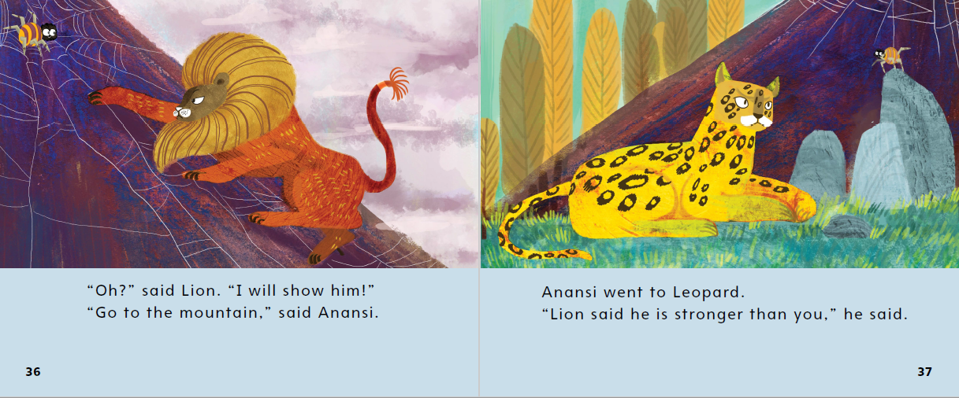
Page 36, 37
First Read – How Anansi Got His Stories
Notes:
Read Together.

Slide 29
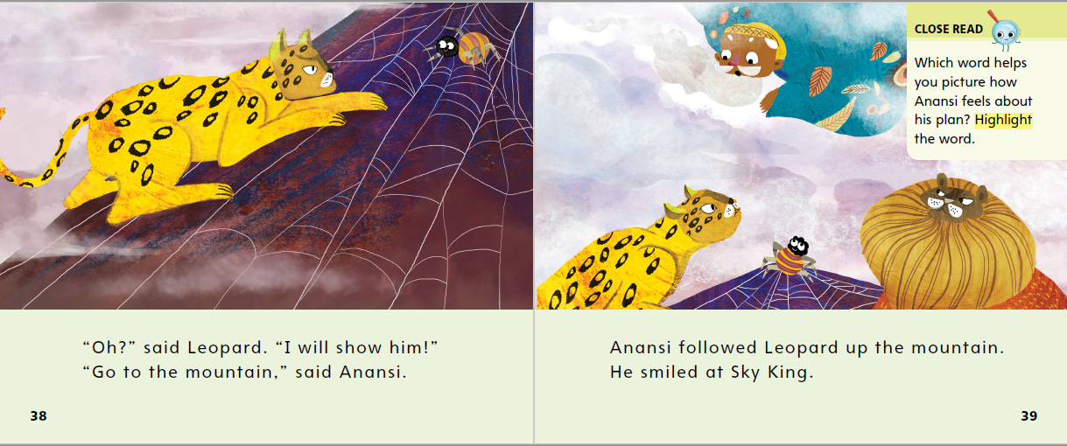
Page 38, 39
First Read – How Anansi Got His Stories
Notes:
Read Together.
THINK ALOUD I see a word I’m not sure about on these pages. I ask myself, "What does the word mountain mean?" Now I look for clues in the words and pictures to find the answer. The text says that Anansi followed Leopard up the mountain. In the pictures, I see Anansi and Leopard on a big mound of rock. Now I know what a mountain is.

Slide 30
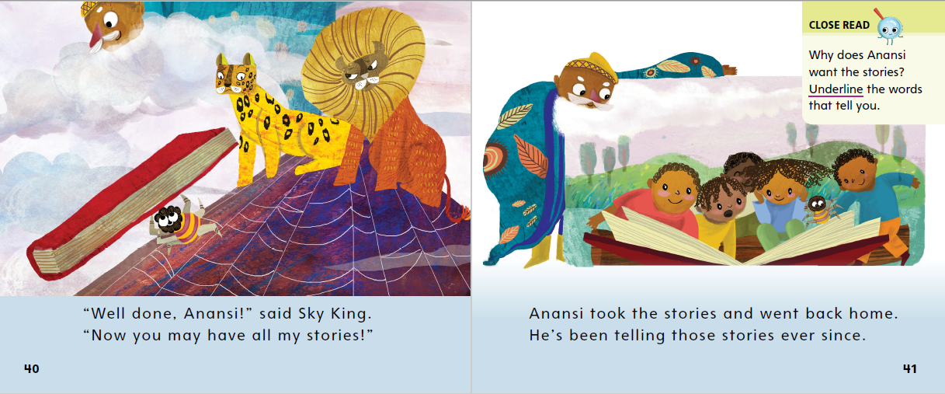
Page 40, 41
First Read – How Anansi Got His Stories
Notes:
Read Together.
Use these suggestions to prompt students’ initial responses to How Anansi Got His Stories.
• THINK What did you like most about How Anansi Got His Stories?
• REFLECT What part surprised you the most?

Slide 31
Respond and Analyze
Think What did you like most about How Anansi Got His Stories?
Reflect What part surprised you the most?
Notes:
Use these suggestions to prompt students’ initial responses to How Anansi Got His Stories.
THINK What did you like most about How Anansi Got His Stories?
REFLECT What part surprised you the most?

Slide 32
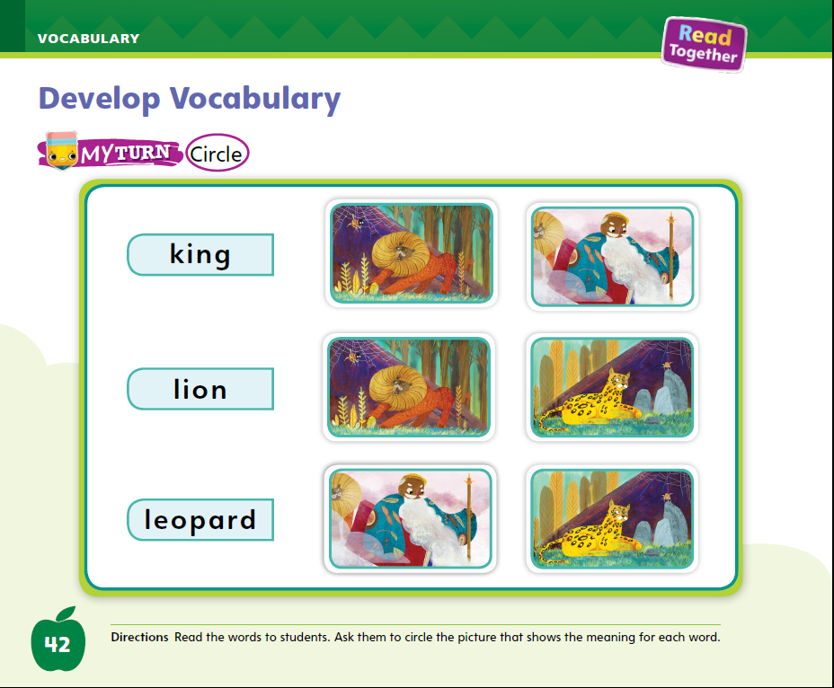
Page 42
Develop Vocabulary
Turn to page 42 in your Student Interactive and complete the activity.
Notes:
Tell students that the author chose words that tell who the characters are in this story: king, lion, leopard.
Look at the pictures. Remind yourself of each vocabulary word.
Ask yourself how you would describe each word. What does it mean?
Have students turn to p. 42 in the Student Interactive. Model how to complete the activity using the word king. Read the word king aloud and then ask students to look at the two pictures that follow. Which picture is a picture of a king? I see that the king is a man with a fancy coat. The other picture is an animal, not a king. I will circle the picture of the king. The king is one of the characters in How Anansi Got His Stories.
Model circling the picture of the king next to the word.

Slide 33
Page 43
Check for Understanding
How does Anansi trick Lion and Leopard?
How does the author tell you the setting of the story?
What problem does Anansi have?
Notes:
Have students complete the Check for Understanding on p. 43 of the Student Interactive.

Slide 34
Writing – Fiction
Stop and Jot
Setting
Characters
Notes:
A fictional story includes characters—the people or animals the story is about. A fictional story also has a setting: when and where the story takes place.
Select a book from the stack and read it aloud to the class. As you read, do a Stop and Jot, using sticky notes to jot details about the setting. Write one word per sticky note.
On additional sticky notes of a different color, write the names of characters.
When you are finished reading, talk about your sticky notes. Explain that a setting is when and where a story takes place. Identify the story’s setting.
Next, explain that characters are usually the people or animals that the story is about. Identify the characters.
Distribute a sticky note to each student. Read aloud another stack text. Have students Stop and Jot about the setting or characters on their sticky note.
When you are finished reading, have students add their sticky notes on a flip chart or board. The author of this book included characters and a setting. When you write your own fiction book, you have to think about what characters you will include. You also have to decide on a setting for your story.

Slide 35
Independent Writing
Let’s recall some of our favorite fictional stories and talk about the characters and setting.
You will start writing your own fiction
book.
Notes:
During independent writing time, tell them to continue exploring the stack books if they need more time to learn about characters and setting.
MODELED Read a stack text aloud and point out the characters and settings.
SHARED Have students recall their favorite fictional story, identifying the characters and setting.
GUIDED Prompt students to identify setting details and the characters.
If some students are ready to write, they can use this time to begin writing their books.
Call on a few students to share the characters and settings from stack books or from books they are writing. Ask the class to discuss what they think might happen to the characters in that setting.

Slide 36
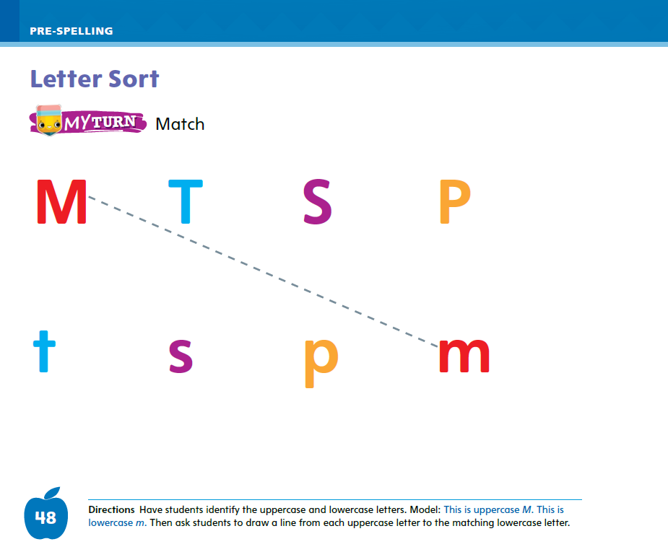
Page 48
Spelling
Oo
Bb
Turn to page 48 in your Student Interactive and complete the activity.
Notes:
Remind students that all letters come in uppercase and lowercase forms. Point to the alphabet and show them that there are two forms of all letters.
Sometimes the lowercase letter is a smaller version of the uppercase letter, such as Oo.
Sometimes the lowercase letter does not look like the uppercase letter, such as Bb.
Have students identify other letters where the uppercase and lowercase letters look similar (for example, Ss). Remind them that the letters spell the same sound, whether they are uppercase or lowercase. A lowercase s spells the same sound as an uppercase S. A lowercase b spells the same sound as an uppercase B.
Turn attention to p. 48 of the Student Interactive. Read aloud the directions and have students complete the activity by drawing a line from the uppercase letter on the top row to the corresponding lowercase letter on the bottom row.

Slide 37
Language and Conventions
Today (your name) is going to tell you about how to use pronouns.
Today I am going to tell you about pronouns.
Anna is reading.
She is reading.
Work with your partner to use a subjective case pronoun in a sentence.
Notes:
Tell students that pronouns are words used in the place of nouns.
Refer to yourself by your name: Today [Ms. Brown] is going to tell you about how to use pronouns. That sounds strange, doesn’t it? That is because we usually use pronouns when referring to ourselves. I would usually say: I am going to tell you about pronouns. Instead of using your name when talking to you, I use the pronoun you. He, she, it, and they are other examples of pronouns that we use in place of a noun. Instead of saying, “Anna is reading” I can say, “She is reading.”
Provide students with a subjective case pronoun and have students work with a partner to use it in a sentence.

Slide 38
Lesson 3

Slide 39
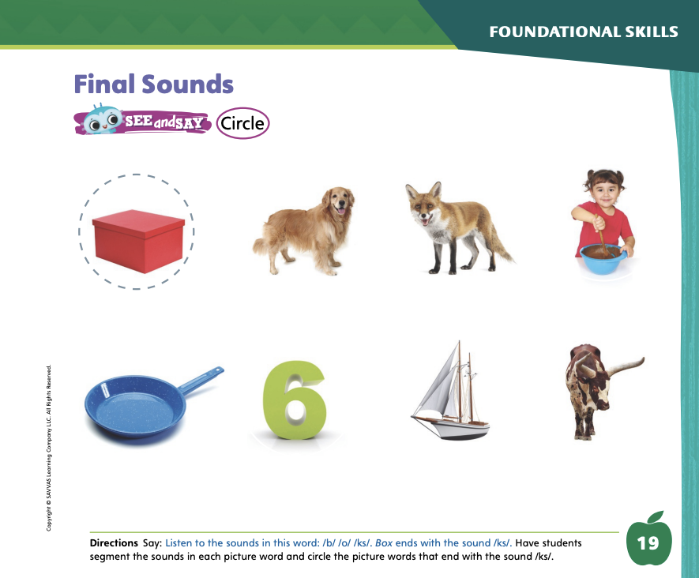
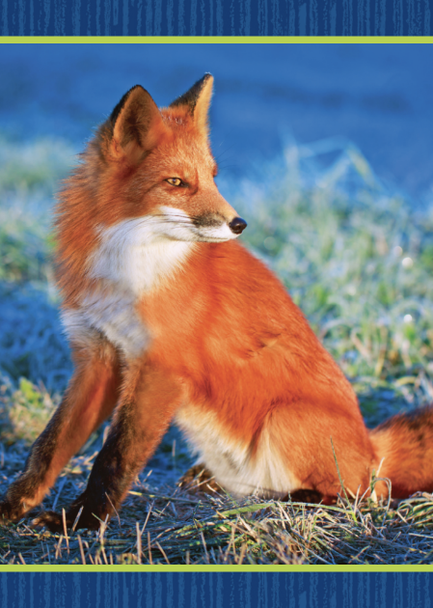
Page 19
Phonological Awareness
Turn to page 19 in your Student Interactive and complete the activity.
Notes:
Today we are going to learn a new sound. Listen carefully: /ks/ /ks/ /ks/. The sound /ks/ is made by combining the sounds /k/ and /s/. Show students how to make the sound /ks/ and have them practice it.
Display the fox Picture Card. This is a fox. Listen to the ending sound as I say this word: /f/ /o/ /ks/. What sound does fox end with? Students should supply the sound /ks/. Click path -> Table of Contents -> Unit 3 Week 1 Folktale -> Lesson 3
Then say the following words and have students give a thumbs-up if they hear the sound /ks/ at the end of the word. Have them give a thumbs-down if they hear another sound at the end of the word: pack, ax, duck, six, bat, tax, fox.
Have students turn to p. 19 in the Student Interactive. Tell them they will circle the picture words that end with the sound /ks/. Have them point to the picture of the box. Listen to the sounds in this word: /b/ /o/ /ks/. Box has the sound /ks/ at the end. Let’s circle the box.
Identify all the words on p. 19 for students. Have them complete the page.

Slide 40

Page 20
Phonics
Xx
Turn to page 19 in your Student Interactive and complete the activity.
Notes:
Tell students that the sound /ks/ is spelled with the letter x. Display the box Picture Card. Tell students the word box ends with x. Turn the card over to display the word box. Point out the spelling of the sound /ks/. Write the letters Xx on the board. Tell students the letters are uppercase X and lowercase x. Slowly trace the letters as you say the sound /ks/. Click path -> Table of Contents -> Unit 3 Week 1 Folktale -> Lesson 3
Have students turn to p. 20 in the Student Interactive. Let’s say the picture word ax and listen to the ending sound: /a/ /ks/. The word ends with /ks/. Can you identify, or tell me, what letter spells the sound /ks/?
Students should trace the uppercase and lowercase letters on the page. Have them point to the letter x and tell you what sound it represents.
Identify all the pictures on p. 20 with students, and then have them complete the activity.

Slide 41
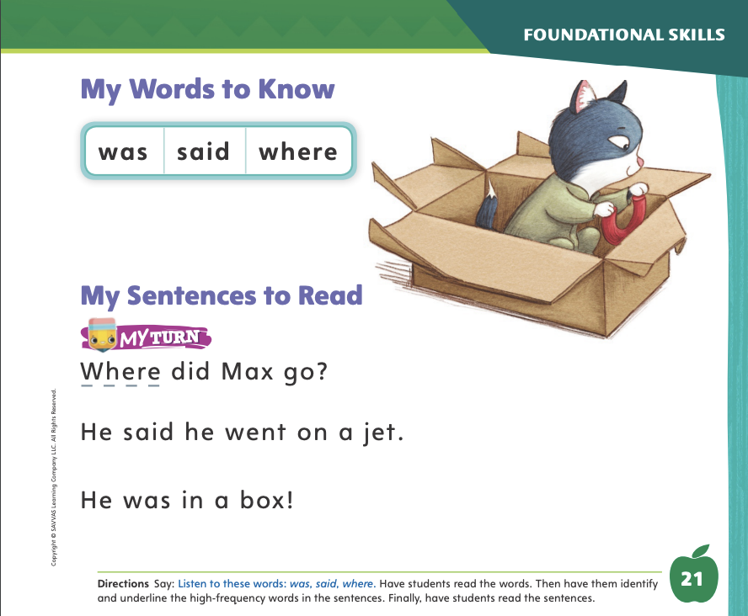
Page 21
High-Frequency Words
was
Turn to page 21 in your Student Interactive and complete the activity.
said
where
Notes:
Tell students that some words are not spelled the way they sound. These words need to be learned by remembering the letters.
Have students read the words at the top of p. 21 in the Student Interactive with you: was, said, where.
Have students look at the words at the top of p. 21. Tell them to point to each word when you say it. Say said. Pause to let students point to the word. Say was. Say where. Repeat the activity until students are familiar with each word.
Have students read the sentences on p. 21 with you. Ask them to identify the words was, said, and where in the sentences.
Then have them read the sentences with a partner. Have them underline the high-frequency words in the sentences

Slide 42
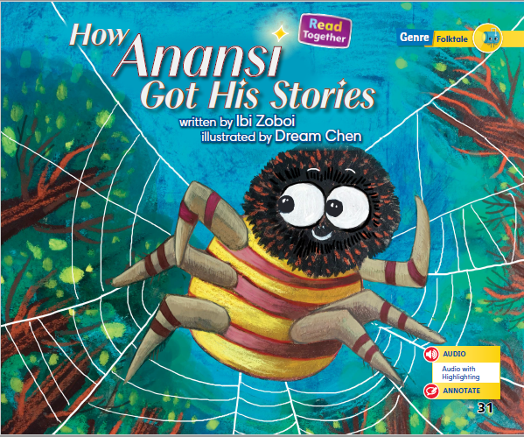
Page 31
Discuss Theme
Notes:
Tell students that the theme is the big idea, or what the author wants readers to know or remember about the story. Readers can figure out the theme by discussing topics and important details in the story and thinking about how the problem is solved in the story. The solution to a problem can be a moral, or lesson, the author wants to tell readers.
Remind students that they just read a folktale, or a traditional story, about Anansi. Explain that they can find evidence to support the theme of the story with adult assistance. I want to discuss the topic and determine the theme, or big idea, of the story. The title is How Anansi Got His Stories. The title tells me that the story will be about Anansi. I can see from the cover that he is a spider. What else does the title tell us? That’s right, it tells us the topic, or what the tale will be about, is how he got his stories!
Now I will go back and reread the text. Read aloud the first sentence. In the first sentence, we learn about a problem that Anansi has. He does not have any stories. I can determine that the theme will be how he uses his wits to solve this problem and get his stories.
Continue by flipping through the pictures and having students use them to discuss the topic of the story and to tell you how Anansi solves his problem. Point out the Close Read notes on pp. 33 and 41 in the Student Interactive and have students underline the parts of the text that tell about the theme. Provide assistance as needed.

Slide 43
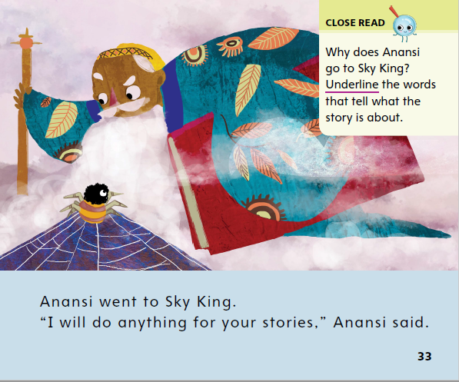
Page 33
Close Read – Discuss Theme
Turn to page 33 in your Student Interactive.
Notes:
Ask students: What is the story mostly about? Then read aloud the Close Read note on p. 33. Prompt students to underline the words that tell what the story is about. DOK 3

Slide 44
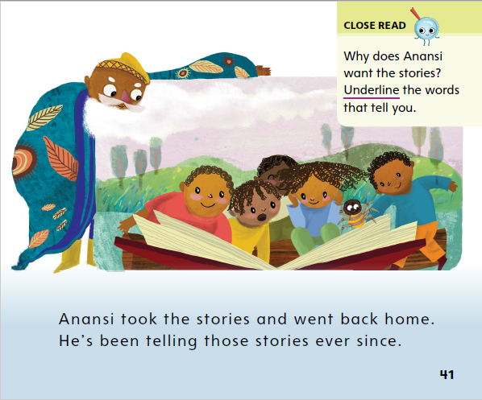
Page 41
Close Read – Discuss Theme
Turn to page 41 in your Student Interactive.
Notes:
Read aloud the Close Read note on p. 41 and ask students to underline the reason that Anansi wants the stories. Tell students that this can help them understand the theme, or big idea. DOK 1

Slide 45
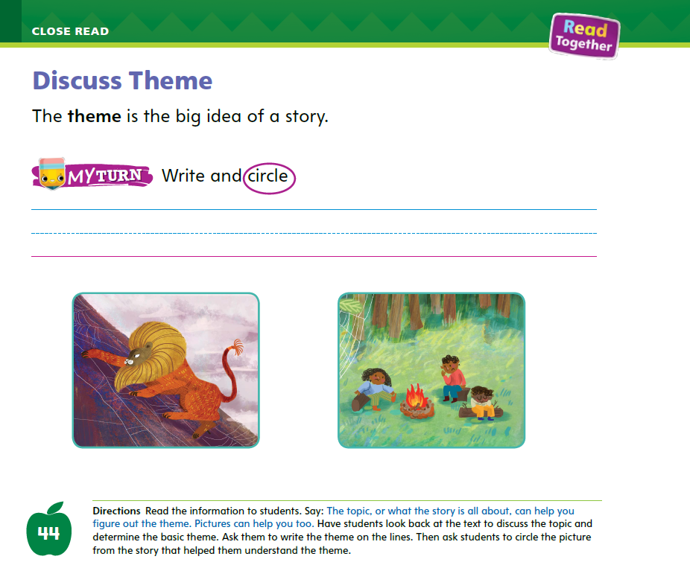
Page 44
Discuss Theme
Turn to page 44 in your Student Interactive and complete the activity.
Notes:
Have students use the strategies for determining theme.
Read the directions at the bottom of p. 44 in the Student Interactive. Then ask students to write or share a sentence about the big idea and circle the picture that helped them understand the theme.

Slide 46
Read Like a Writer, Write Like a Reader
What words might an author use to describe how a character feels?
What do people look like when they are happy?
Notes:
Tell students that authors use words to help readers visualize the story. Authors may say how the characters think and feel. They may describe what characters look and sound like.
Help students think of words an author might use to describe how a character feels. Guide them to feeling words, such as happy, sad, angry, or excited.
Point out that authors might show a character is happy without using that word. Ask students: What do people look like when they are happy? Guide students to recognize how behaviors like smiling, cheering, or skipping can suggest a character is happy.

Slide 47
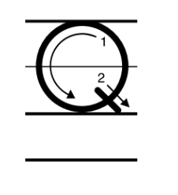
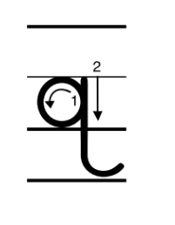
Handwriting
Notes:
Show students the alphabet and point out the letters Qq. Help students to recognize that capital Q looks like an O with a small line on it and the lowercase q has a circle, a line, and a tail.
Make sure students know to begin at the top line when writing a capital letter. Model how to write a Q and have students follow your example.
Then draw a lowercase q on the board. Point out that it goes below the line and swoops like a j, but in the opposite direction. Have students draw a q in the air as you model.
Provide students with lined paper and have them practice writing uppercase Q across the top line. Then have them practice writing lowercase q on the next line.

Slide 48
Writing – Fiction
Plot
Can you guess what a plot is?
Notes:
The plot of a story includes the events that make up the story. The events are usually connected and are in a sequence.
Write the word Plot on a flip chart or board. Help students sound out and say the word. Ask students to guess what a plot is.
Write down their guesses. Then say: The plot is the action in the story. All of the events that happen in a story make up the plot. Let’s read a book to see how the author writes the plot.
Read a stack text aloud. When you are finished, recall the events and action in the story. Make a list of the events, asking students to recall the story. What happened first, next, and last? Write the events in order on the board or flip chart.
Then repeat the activity with a second stack text. When students show understanding of plot, say: Just like this author, we will write stories. Our stories will have a plot.

Slide 49
Independent Writing
Let’s look at some fiction books to see how authors write the plot of their books. Can you tell us the plot of your favorite story?
You will write or draw the plot for your story. Share your plot ideas with our class.
Notes:
During independent writing, have students read additional stack texts to see how authors write the plot of their books.
Modeled Read a stack book aloud and identify the sequence of events in the plot.
Shared Have students tell the plot of their favorite story.
Guided Tell students to identify their plot events in detail.
If students show understanding, have them transition to writing or drawing the plot for their story.
Have a few students share their plot ideas with the class. Tell the class to ask questions and provide suggestions for the plot, setting, or characters.

Slide 50
Language and Conventions
Mark held the door.
He is very helpful.
The blocks are put away. They are in the box.
Notes:
Explain that pronouns take the place of nouns.
To reinforce the instruction, have students identify subjective pronouns. Write the following sentences on the board: Mark held the door. He is very helpful. Ask: What word is the pronoun? (He) What word does it replace? (Mark)
Say: “The blocks are put away. They are in the box.” Which word is a pronoun? (They)
Then ask a question and have volunteers respond with an answer using a pronoun: What is Grace doing? (She is ___.) What will you do after school? (We will ___. I will ___.)

Slide 51
Lesson 4

Slide 52
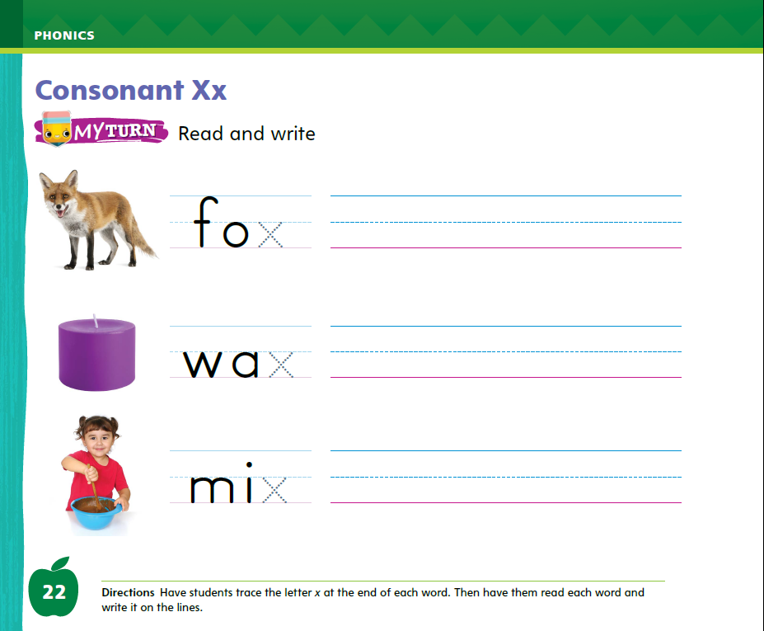
Page 22
Phonics
Turn to page 22 in your Student Interactive and complete the activity.
Notes:
Hold up the fox Picture Card. This is a picture of a fox. I hear the sound /ks/ at the end of fox. Say the sound /ks/ with me. Click path -> Table of Contents -> Unit 3 Week 1 Folktale -> Lesson 4
Turn over the card and show students the spelling of the word. Point to the x and say /ks/. Do you hear the sound /ks/? What letter spells the sound /ks/? Have students identify the letter x. Write the letters Xx on the board. Have students trace the letters Xx in the air as you lead them.
Point to the letters Xx on the board. Listen carefully to the following words: fix, box. Both words have the sound /ks/ in them. Listen again: /f/ /i/ /ks/; /b/ /o/ /ks/. Write the words fix and box on the board. Read the words, pointing to each letter as you say the sound. Ask volunteers to point to the letter x in each word. Ask them what sound the letter x spells.
Have students complete p. 22 in the Student Interactive.

Slide 53
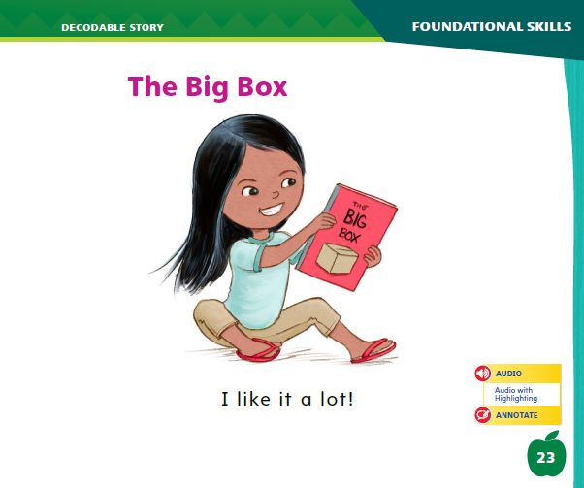
Page 23
Decodable Story
was
said
where
Turn to page 23 in your Student Interactive. We will Read “The Big Box”.
Notes:
Have students turn to p. 23 in the Student Interactive. Say: We are going to read a story today about some animals who go on an adventure.
Point to the title of the story. The title of the story is The Big Box. I hear the sound /ks/ in the word box. In this story, we will read words that have the sounds /j/ and /ks/.
Remind students of this week’s high-frequency words: was, said, where. Tell them they will practice reading these words in the story The Big Box. Display the words. Have students read them with you. Say: When you see these words in the story The Big Box, you will know how to identify and read them. You will also see other high-frequency words you have learned: a, we, they, that.
Have students whisper read the story as you listen in. Then have students reread the story page by page with a partner. Listen carefully as they use letter-sound relationships to decode. Have partners read the story again. This time the other student begins.
After students have read the story, call their attention to the title. I see the letter x in a word in the title. What sound does the letter x spell? Help them identify, or say, the sound /ks/. Then have students read the word Box on p. 23.

Slide 54
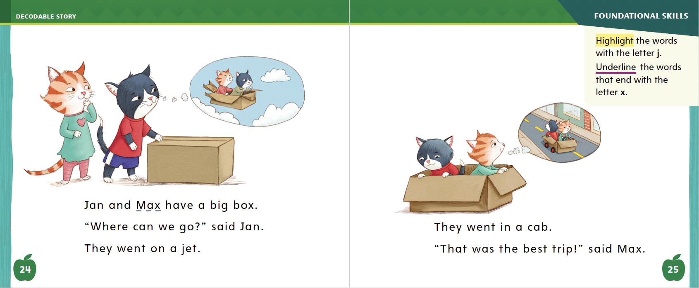
Page 24, 25
Decodable Story
Notes:
Have students turn to pp. 24–25. Which words include the sound /j/ spelled j and the sound /ks/ spelled x? Point to them. Help students identify the sounds /j/ and /ks/.
Then have them find and highlight the words with the sound /j/ spelled j and underline the words with the sound /ks/ spelled x.
Have them tell you the high-frequency words they see.

Slide 55
Page 34
Visualize Details
Notes:
Explain that visualizing is a technique that readers use to better understand what they read. To visualize:
Picture what is happening in your mind. Pretend you are there.
Use all five senses. What might the setting look, sound, feel, smell, and taste like? What do the characters look and sound like?
Look at the words the author uses to describe the characters, setting, and events. What does this tell you about what is happening?
Have students look back at the pictures in How Anansi Got His Stories. Point out that the setting is high on a mountain in the clouds. Model visualizing the scene shown on p. 34: I can see that the king lives high in the clouds. He looks very powerful and is carrying a big book. The long beard makes him seem very wise. The text says he said, “Bring me Lion and Leopard.” I imagine his voice to be very deep and serious.
Use the Close Read notes on pp. 35 and 39 and assist students as they highlight the words that are most helpful for visualizing what happens in the text.

Slide 56
Page 34, 35
Close Read – Visualize Details
Turn to pages 34 and 35 in your Student Interactive.
Notes:
Read aloud the Close Read note on p. 35. Remind students that visualizing involves picturing in their minds what is happening in the story. Say: So Anansi left Sky King. Then what does he do?
Reread the text and have students highlight the words that help them visualize what Anansi does. DOK 2

Slide 57
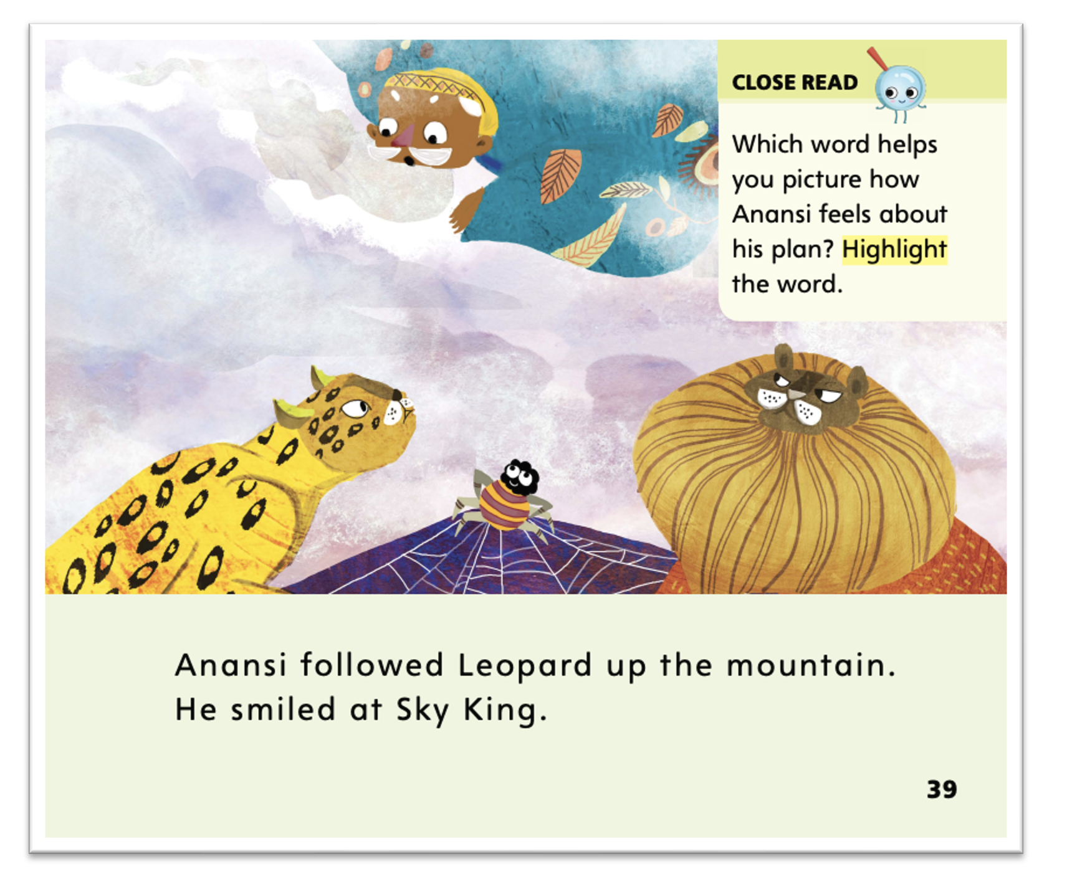
Page 39
Close Read – Visualize Details
Turn to page 39 in your Student Interactive.
Notes:
Read with students the Close Read note on p. 39. Have them highlight the word that helps them visualize how Anansi feels about his plan. DOK 2

Slide 58
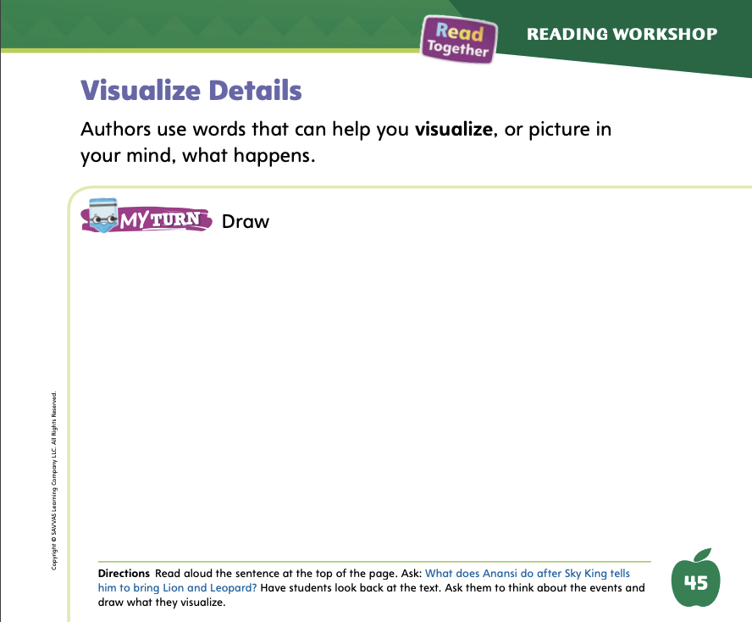
Page 45
Visualize Details
Turn to page 45 in your Student Interactive and complete the activity.
Notes:
Have students use the strategies for visualizing details.
Read aloud the directions on p. 45 in the Student Interactive. Then have students draw a picture in order to practice creating mental images to deepen understanding.

Slide 59
Writing – Fiction
Characters | Setting | Plot
Notes:
Generating ideas for a story can be fun, but it can also be a lot of work. The characters, setting, and plot all have to fit together and make sense.
Display a book from the stack. Ask students where the author might have gotten the idea for the book. For example, a book about a cat might have been inspired by the author’s pet. If the book has an author biography, read it aloud. Repeat with other stack books.
Say: Story ideas can come from anywhere. Authors need to brainstorm ideas about characters, settings, and plots. We can think of ideas for stories too. To think of ideas, think about the characters you can include. Should the characters be animals or people? Think about the setting. What are some interesting places we could use as the setting? Also think about the plot. What problem can the characters have? What events can happen in the setting you chose?
Help students brainstorm ideas and write their suggestions on a flip chart or board.

Slide 60
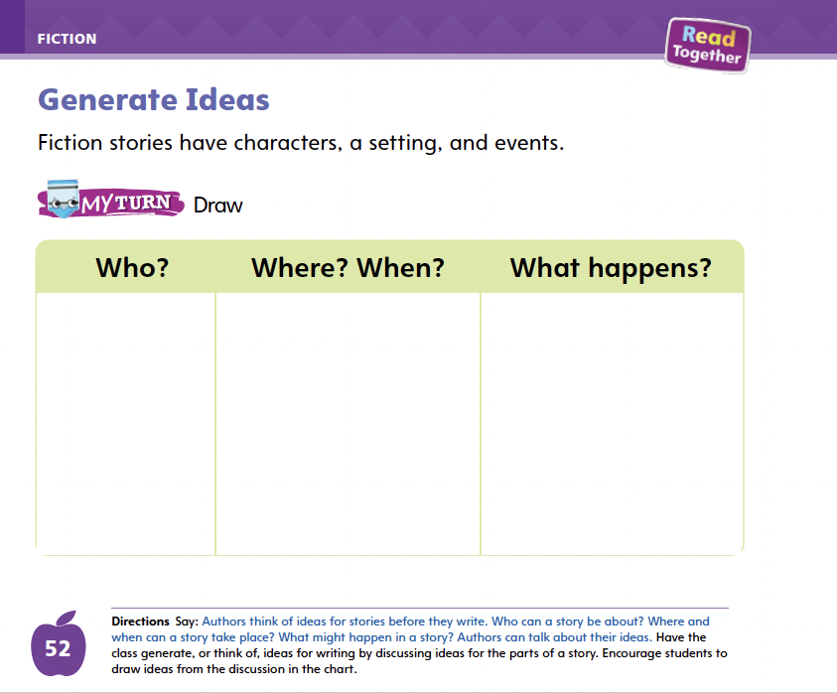
Page 52
Writing – Fiction
Turn to page 52 in your Student Interactive and complete the activity.
Notes:
As they generate ideas as a class, have students complete p. 52 in the Student Interactive. Explain that what they write in the “What happens?” column will be used to think of the plot for their story.

Slide 61
Independent Writing
Now you will come up with an idea for your story. Check the flip chart or stack texts for help generating ideas.
You will write about your idea in your booklet or start a new story.
Notes:
After this lesson, students should transition into independent writing.
If students find it difficult to come up with an idea, refer them to the ideas the class brainstormed on the flip chart or board.
MODELED Use stack texts to generate ideas for stories.
SHARED Prompt students to generate ideas by looking through the stack texts or class library.
GUIDED Have students think about a question or challenge for which they would like to make up an answer.
Encourage students to continue to write about their idea in their stapled booklets. Tell them they can start a new story if they find an idea they like better.
Invite a few students to share their story ideas with the class. Tell students to talk about why they chose that idea and what setting, characters, or plot they might include in their story.

Slide 62
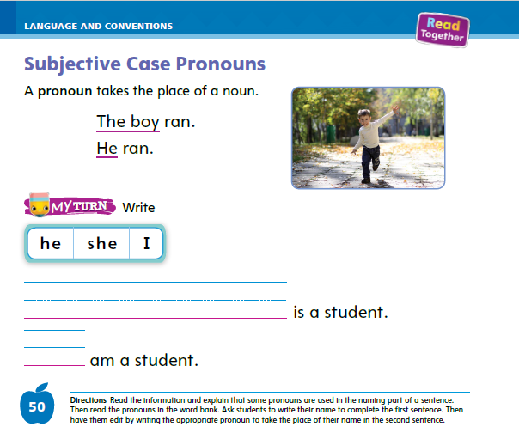
Page 50
Language and Conventions
Turn to page 50 in your Student Interactive and complete the activity.
Notes:
Have students edit for subjective case pronouns on p. 50 of the Student Interactive.

Slide 63
Lesson 5

Slide 64
Phonological Awareness
The quilt is blue and red.
How many words are
in each
sentence?
My cat zigs and zags.
Matt can zip his coat.
I will not quit the team.
Notes:
Listen carefully as I say a sentence: The quilt is blue and red. Repeat the sentence with me. Have students repeat the sentence and clap as they say each word. Repeat the sentence and have students count the words. How many words are in the sentence? Yes, there are six words in the sentence.
Say sentences, such as: My cat zigs and zags. Matt can zip his coat. I will not quit the team. Have students say each sentence aloud and clap once for each word. Then have them tell you how many words are in the sentence.
Say the following sentences: The jaguar lives in the jungle. The fox is red. The girl jogs. Have students clap once for each word and tell you how many words are in each sentence.

Slide 65
High-Frequency Words
was
said
where
Notes:
(Note: Move the orange boxes to cover each bold spelling word before you read aloud the words and sentences.)
Remind students that high-frequency words are words that appear over and over in texts. Remind them they will be learning many of these words this year, and the words will help them become better readers.
Say the word her and ask students what letters spell the word. Have students
say the letters as you write them on the board.
repeat with said and where.

Slide 66
Reflect and Share
Anansi
Tortoise
Notes:
Explain to students that it can be helpful to compare different characters from different texts with each other. Some characters are similar to each other. Other characters are different from each other.
To compare characters:
Try to visualize what each character looks like.
Think about what the characters do in the stories where they appear.
Think about how the characters are the same and different.
Model comparing characters by reminding students about Anansi from the main selection and the Tortoise from the infographic.
Say: Both Anansi and the Tortoise were smaller than the other characters. Both of them had to find a way to get what they wanted. Tortoise won the race because Hare went to sleep; Anansi got Lion and Leopard to come to the mountain because they wanted to be stronger than each other.
Discuss the comparison further with students.

Slide 67
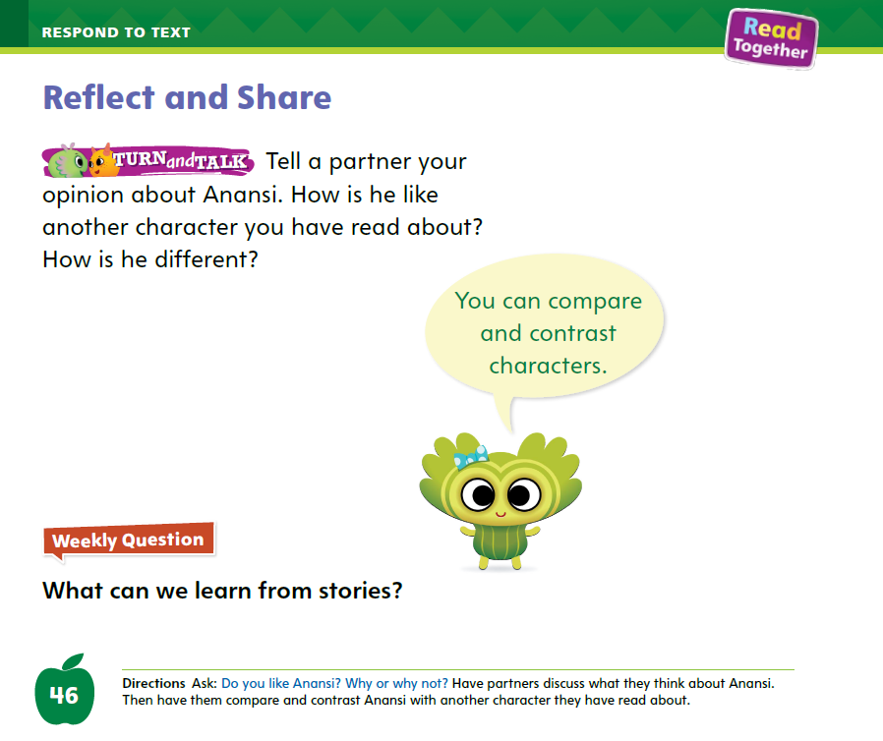
Page 46
Apply
Turn to page 46 in your Student Interactive.
Notes:
Have students use the strategies for sharing information and ideas across texts.
Have students turn to p. 46 in the Student Interactive and read aloud the Turn and Talk prompt. Have partners talk about how this book compares to other texts.

Slide 68
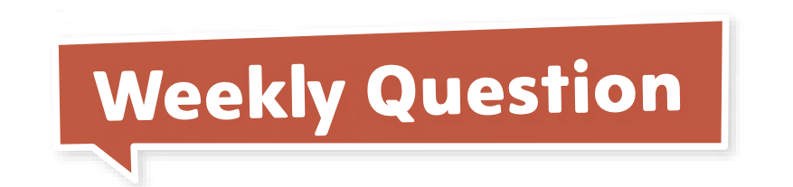
Page 46
Apply
What can we learn from stories?
Notes:
Have students use evidence from the texts they have read this week to respond to the Weekly Question.
Tell them to discuss in small groups or write or draw their responses on a separate sheet of paper.

Slide 69
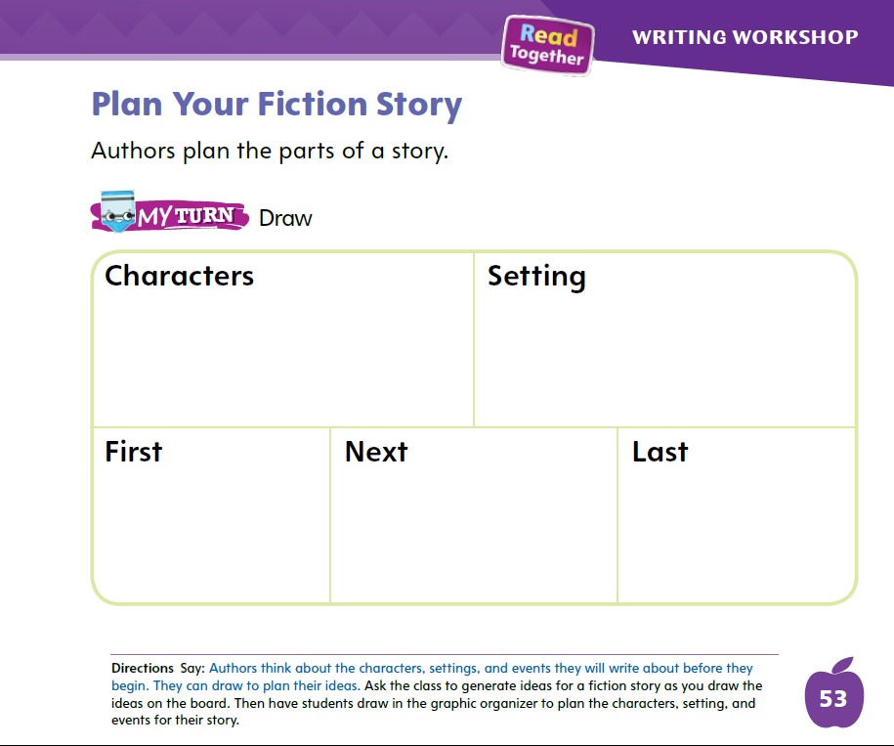
Page 53
Writing – Fiction
Turn to page 53 in your Student Interactive.
Notes:
Authors plan their stories before they write them. Planning out the story helps an author think through the setting, characters, plot, and details. During the planning stage, authors may outline their story to see how they will organize it.
Ask students to share a time when they planned something before doing it. Explain to students that writers plan their fictional story before writing it. An author often outlines the story to make sure details about the setting, characters, and plot are included. An outline helps the author organize the plot and think about the sequence of events in a story.
Direct students to p. 53 in the Student Interactive. Think aloud as you model using the graphic organizer to plan a story based on an idea generated by the class. Make notes or draw a picture about your story’s characters and setting, making sure to include some detail so students can visualize.
Next, think through the actions that will make up your story. Invite volunteers to suggest plot events too. As you fill in the sequence of events, show students that during the planning stage, authors often change their minds.
Model revising the details of the plot by erasing, crossing out, or moving around your ideas in the graphic organizer.
When you are finished, review your work with the class. Ask them for suggestions for your story. Model accepting or rejecting their suggestions and adjusting your graphic organizer accordingly.
Ask students with whom you conferred to show their graphic organizers to the class. Prompt students to talk about the changes they made during the planning stage. Did they change their characters, setting, or events? Tell students to talk about why it is important to plan a story before writing it.

Slide 70
Language and Conventions
Which word in these sentences is a pronoun?
Rose sees two friends. She waves.
She
two
Rose
Notes:
Display the following sentences. Read aloud the sentences and then each answer choice.
Rose sees two friends. She waves.
Which word in these sentences is a pronoun?
A She
B two
C Rose
Have students complete Language and Conventions, p. 148, from the Resource Download Center. Click path: Table of Contents -> Resource Download Center -> Language and Conventions -> U3 W1

Slide 71
Unit 3: Week 1
Grade K

